Slide 1



Slide 2







Assistant Professor|
In-charge Intelligent Machines and Robotics
Department of Computer Science, CUI Lahore
Co-founder, Chairperson
Neocog Pvt Ltd
Co-founder, Executive Director
eCOG(Pvt) Ltd
Co-founder, Executive Director
Quick Bee (Pvt) Ltd [in progress]
Consultant (AI & Robotics)
Arctan Engineering Solutions; Services Syndicate; MegaKart
Executive Director
Institute of Molecular Sciences & Bioinformatics
IEEE Lahore Section Treasurer
Founding Vice Chair IEEE RAS Pak Joint Chapter
In charge IEEE RAS CUI Lahore
Member Expert/Focus Group of Coordination Committee on AI & Robotics, Ministry of Science & Technology, Govt Pakistan
Member, Technology Foresight Committee for Robotics for Vision 2025, Pakistan Commission for Science & Technology, Govt of Pakistan
Invited to Prime Minster’s House, Governor House, Chief Minister House and Air Force (Kamra) ….
Member Evaluation Board of National Center for Artificial Intelligence, Pakistan
PPSC Govt of Punjab Ex-Exam-Paper Setter
Worked for NDC, Ministry of Defense
Dr. Wajahat M. Qazi
PhD (Machine Consciousness)
Asia Pacific United Nations Educational, Scientific and Cultural Organization (UNESCO) Committee on Ethic in Artificial Intelligence
Member Technical Committee, IEEE RAS Cognitive Robots

Slide 3

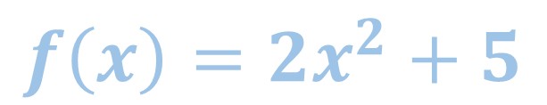

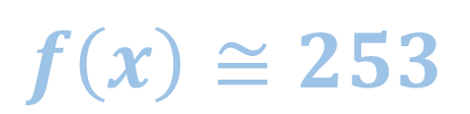
Evolutionary Computing
Genetic Algorithms
Example

Slide 4
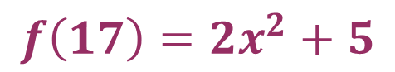
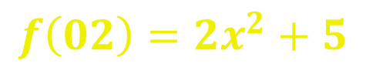
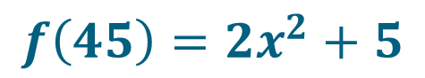
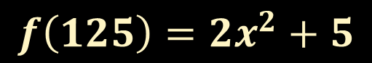
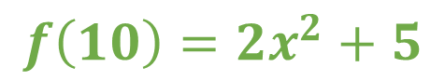
Evolutionary Computing
Genetic Algorithms
Example:
Max Pop: 5
1- Initialize Population
Population
0
0
1
0
0
0
1
Step 2
0
0
0
0
0
1
0
0
1
0
1
1
0
1
1
1
1
1
1
0
1
0
0
0
1
0
1
0

Slide 5
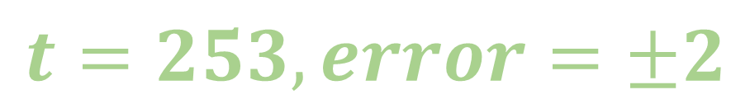
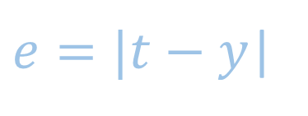

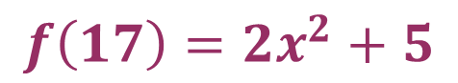



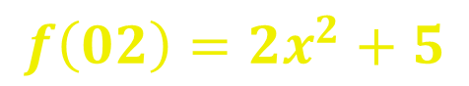



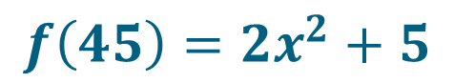



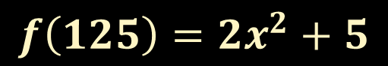
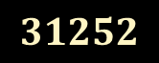


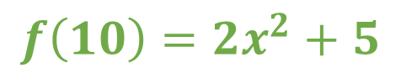

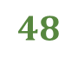

Evolutionary Computing
Genetic Algorithms
Example:
Max Pop: 5
2- Fitness Evaluation
Population
e
Fit
0
0
1
0
0
0
1
Step 2
0
0
0
0
0
1
0
0
1
0
1
1
0
1
1
1
1
1
1
0
1
0
0
0
1
0
1
0

Slide 6

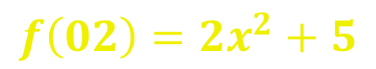
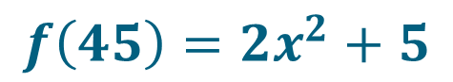


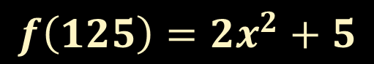
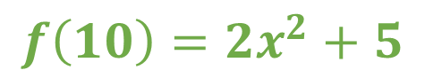
Evolutionary Computing
Genetic Algorithms
Example:
Max Pop: 5
2- Fitness Evaluation
Population
e
Fit
0
0
1
0
0
0
1
Step 2
0
0
0
0
0
1
0
0
1
0
1
1
0
1
1
1
1
1
1
0
1
0
0
0
1
0
1
0

Slide 7

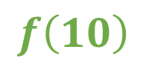

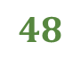

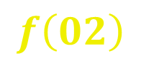

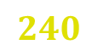

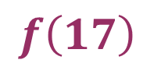



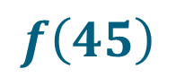
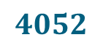



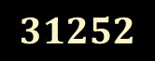


Evolutionary Computing
Genetic Algorithms
Example:
Max Pop: 5
3- Genetic Operators
Population
e
Fit
Pairs
0
0
0
1
0
1
0
10
02
Step 2
0
0
0
0
1
0
0
02
17
0
0
1
0
0
0
1
17
45
0
1
0
1
1
0
1
45
125
1
1
1
1
1
0
1

Slide 8
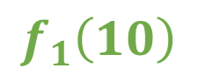
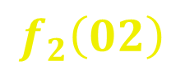

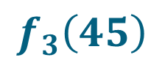

Genetic Algorithms
Evolutionary Computing
Genetic Algorithms
Example:
Max Pop: 5
Crossover
3- Genetic Operators
Population
Crossover:
Random Selection
0
0
0
1
0
1
0
10
02
0
0
0
0
0
0
1
Step 2
0
0
0
0
1
0
0
02
17
0
0
1
0
0
0
1
17
45
0
0
0
1
0
1
0
0
1
0
1
1
0
1
45
125
1
1
1
1
1
0
1

Slide 9



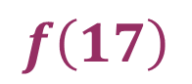


Genetic Algorithms
Evolutionary Computing
Genetic Algorithms
Example:
Max Pop: 5
0
0
0
0
0
1
0
2- Genetic Operators
10
02
0
0
0
1
0
1
0
Population
0
0
0
1
0
0
1
0
0
0
0
1
0
1
02
17
Step 2
0
0
0
0
1
0
0
0
0
0
0
0
1
0
0
0
1
0
0
0
1
0
0
0
1
1
0
1
17
45
0
1
0
1
1
0
1
0
1
1
0
0
0
1
1
1
1
1
1
0
1
1
1
0
1
1
0
1
45
125
0
1
1
1
1
0
1

Slide 10
Genetic Algorithms
Evolutionary Computing
Genetic Algorithms
Example:
Max Pop: 5
0
0
0
0
0
1
0
3- Genetic Operators
10
02
0
0
0
1
0
1
0
Population
0
0
0
1
0
0
1
0
0
0
0
1
0
1
02
17
Step 2
0
0
0
0
1
0
0
0
0
0
0
0
1
0
0
0
1
0
0
0
1
0
0
0
1
1
0
1
17
45
0
1
0
1
1
0
1
0
1
1
0
0
0
1
1
1
1
1
1
0
1
1
1
0
1
1
0
1
45
125
0
1
1
1
1
0
1

Slide 11

Evolutionary Computing
Genetic Algorithms
Example:
Max Pop: 5
0
0
0
0
0
1
0
2
3- Genetic Operators
0
0
0
1
0
1
0
10
Population
0
0
0
1
0
0
1
0
18
0
0
0
1
0
1
Step 2
0
0
0
0
1
0
0
0
0
0
0
0
1
1
0
0
0
1
0
0
0
1
0
0
0
1
1
0
1
13
0
1
0
1
1
0
1
0
1
1
0
0
0
1
49
1
1
1
1
1
0
1
1
1
0
1
1
0
1
109
0
1
1
1
1
0
1
61

Slide 12

Evolutionary Computing
Genetic Algorithms
Example:
Max Pop: 5
Mutation:
Random Selection
0
0
0
0
0
1
0
2
3- Genetic Operators
0
0
0
1
0
1
0
10
Population
0
0
0
1
0
0
1
0
18
0
0
0
1
0
1
Step 2
0
0
0
0
1
0
0
0
0
0
0
0
1
1
0
0
0
1
0
0
0
1
0
0
0
1
1
0
1
13
0
1
0
1
1
0
1
0
1
1
0
0
0
1
49
1
1
1
1
1
0
1
1
1
0
1
1
0
1
109
0
1
1
1
1
0
1
61

Slide 13
Evolutionary Computing
Genetic Algorithms
Example:
Max Pop: 5
0
0
0
0
0
1
0
2
1
34
3- Genetic Operators
0
0
0
1
0
1
0
10
Population
1
0
40
0
0
1
0
0
1
0
18
0
0
0
1
0
1
0
1
26
0
0
0
0
0
0
1
1
Step 2
0
0
0
0
1
0
1
0
65
0
0
0
1
1
0
1
13
0
0
1
0
0
0
1
1
15
0
1
1
0
0
0
1
49
0
1
0
1
1
0
1
0
48
1
1
1
1
1
0
1
1
1
0
1
1
0
1
109
0
101
0
1
1
1
1
0
1
61
0
0
41

Slide 14
Evolutionary Computing
Genetic Algorithms
Example:
Max Pop: 5
0
0
0
0
0
1
0
2
1
34
2- Population Selection
0
0
0
1
0
1
0
10
Population
1
0
40
0
0
1
0
0
1
0
18
0
0
0
1
0
1
0
1
26
0
0
0
0
0
0
1
1
Step 2
0
0
0
0
1
0
1
0
65
0
0
0
1
1
0
1
13
0
0
1
0
0
0
1
1
15
0
1
1
0
0
0
1
49
0
1
0
1
1
0
1
0
48
1
1
1
1
1
0
1
1
1
0
1
1
0
1
109
0
101
0
1
1
1
1
0
1
61
0
0
41

Slide 15
Evolutionary Computing
Genetic Algorithms
Example:
Max Pop: 5
2- Population Selection
Population
New Population
1
0
0
0
0
0
0
1
0
0
0
0
1
0
1
34
Step 2
0
0
0
0
1
0
1
0
0
0
0
0
0
1
1
0
40
0
0
1
0
0
0
1
0
0
1
0
0
1
0
1
26
0
1
0
1
1
0
1
0
0
0
0
0
0
1
1
65
1
1
1
1
1
0
1
0
0
0
1
1
0
1
1
15

Slide 16
Evolutionary Computing
Genetic Algorithms
Example:
Max Pop: 5
Population
0
0
0
0
0
1
0
1
34
Go to to step 2 for fitness eval and so on
Step 2
1
0
0
0
1
0
0
1
0
40
0
0
1
0
0
1
0
1
26
0
0
0
0
0
0
1
1
65
0
0
0
1
1
0
1
1
15

Slide 17


